Slide 1
NODE.JS
(The Backend Of MERN Stack)
Lecture 4

Slide 2
Today’s Agenda
Introduction To fs Module
Types Of Methods In fs Module
Checking For File Existence
Writing In File
Handling Exceptions In File Operation

Slide 3
The fs module
Working with files and directories is one of the basic needs of a full-stack application.
Your users may want to upload images, resumes, or other files to a server.
At the same time, your application may need to read files, move files, or even change their permissions programmatically.

Slide 4
The fs module
The Node.js fs module has got all these covered.
It provides several APIs to interact with the file systems seamlessly.

Slide 5
The fs module
fs is called the File System module and it allows us to access the operating system’s file system.
It provides all sorts of interesting utilities related to the file system like:
Read from a file
Write or append in a file
Search a given file or directory etc

Slide 6
Three ways of dealing with files
Since Node v10, the fs module has included three different APIs for interacting with files and they are:
synchronous
callback
promise
All three APIs expose the same set of file system operations.

Slide 7
Synchronous api
The synchronous API exposes a set of functions that block execution to perform file system operations.
Means that , they block the main thread.

Slide 8
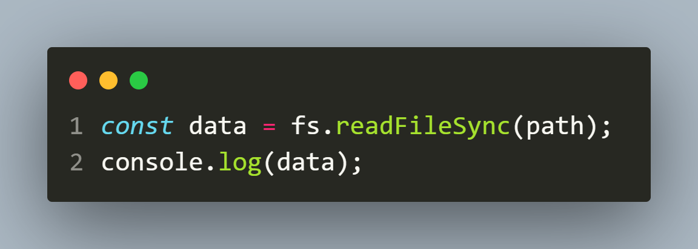
Synchronous api
Here is an example of using the synchronous API to read the contents of a file:

Slide 9
Synchronous api
Blocking the main thread in Node.js is considered to be a bad practice because of the non-blocking I/O design of Node.js.
But these functions tend to be the simplest to use when you’re just getting started.

Slide 10
Synchronous api
Also , there are times where you must process a file in a synchronous way, like reading or loading the configuration files

Slide 11
callback api
The callback API allows us to interact with the file system in an asynchronous way.
Each of the callback API functions accept a callback function that is invoked when the operation is completed.

Slide 12
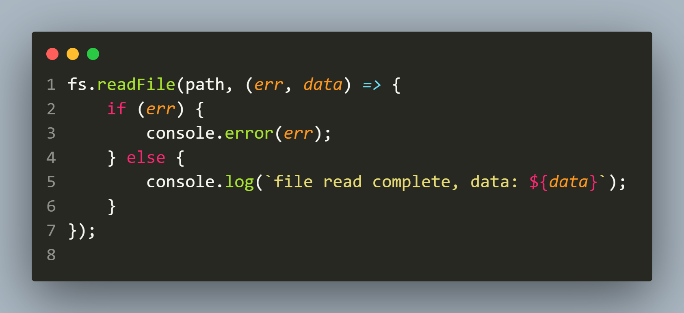
callback api
For example, we can call the readFile() function with an arrow function that receives an error if there is a failure or receives the data if the file is read successfully:

Slide 13
Callback api
This is a non-blocking approach that is usually more suitable for Node.js applications, but it comes with its own challenges.
Using callbacks in asynchronous programming often results in callback hell

Slide 14
What is callback hell ?
Callback hell in Node.js is the situation in which we have complex nested callbacks.
In this, each callback takes arguments that have been obtained as a result of previous callbacks.
It results into lesser code readability and maintainability.

Slide 15
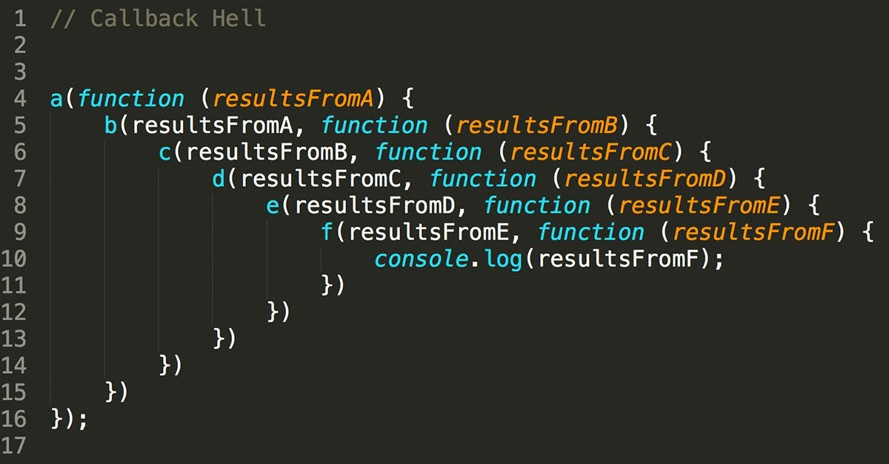
What is callback hell ?

Slide 16
Promise based api
When the fs module was first created, the primary way to write asynchronous code in Node.js was through callbacks.
But as promises grew in popularity, the Node.js team worked to support them in the fs module out of the box.

Slide 17
Promise based api
In 2018 , in Node.js version 10, they added experimental support to promises in fs module but in Node,js 11 promises were fully supported .
However they created a promises object in the fs module that uses promises, while the main fs module continues to expose functions that use callbacks.

Slide 18
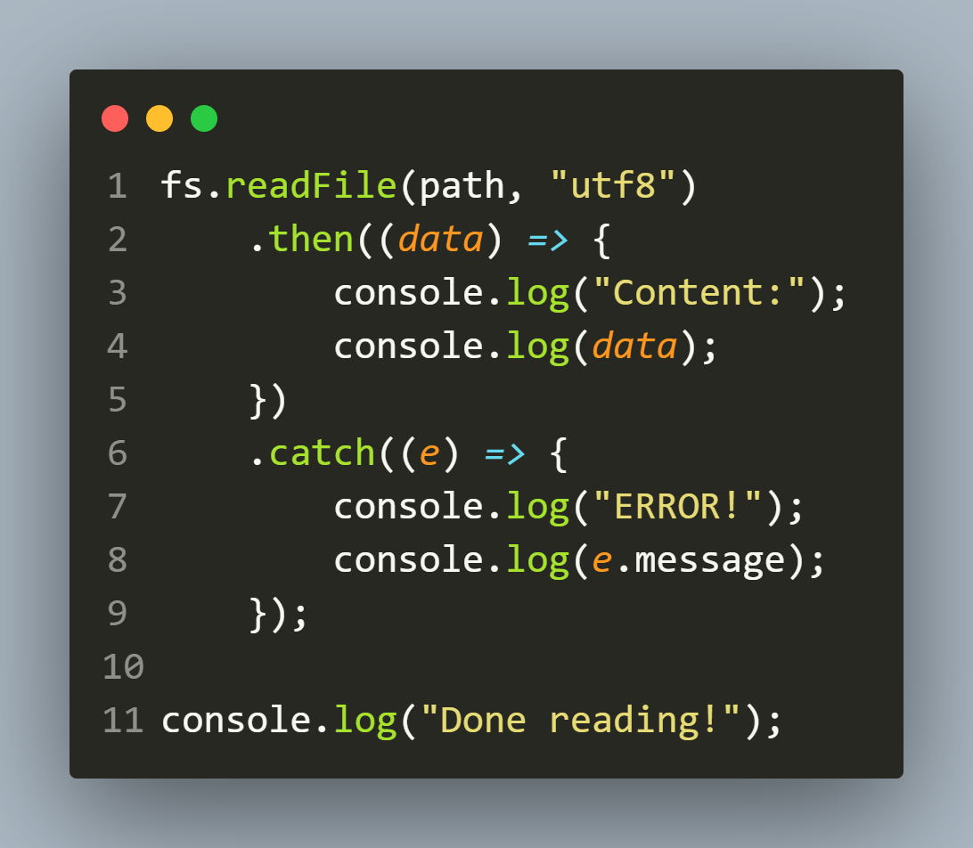
Promise based api
The promise-based file system methods work the same as the callback-based ones, but instead of a callback a Promise is returned:

Slide 19
Checking for file existence
Before reading or writing a file using the fs module of Node.js it’s important to check whether the file exists or not.
The fs module provides a method called fs.existsSync(path) to check if a file exists at the given path.

Slide 20
The fs.existsSync() method
Syntax:
fs.existsSync(path)
path: It is a String, Buffer or URL that denotes the path of the file or directory whose existence has to be tested.
Return Value: Returns true if the path exists, otherwise returns false.

Slide 21
Exercise 1
WAS to check whether a file called message.txt is present in the text_files folder of your app .
If it is present then print the message File exists otherwise print the message File does not exists

Slide 22
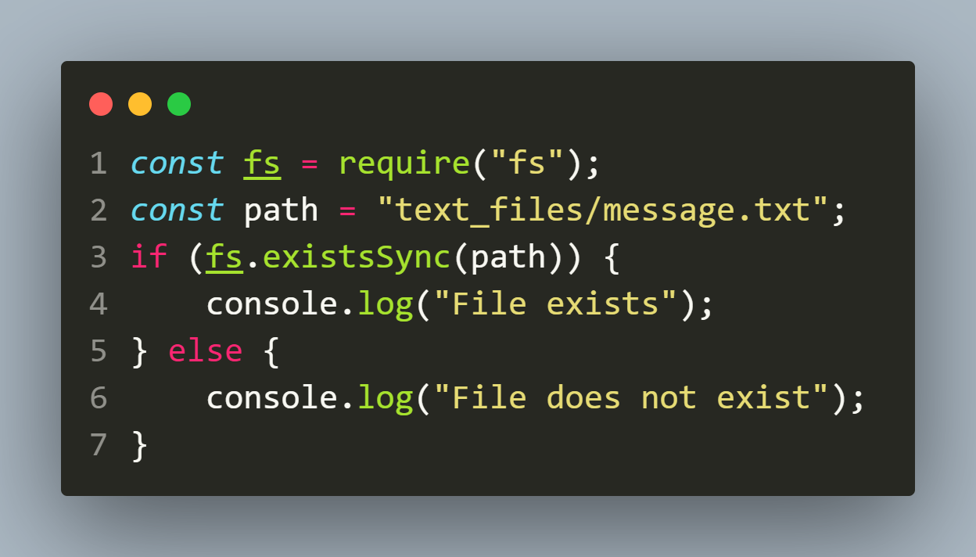
Solution

Slide 23
Using asynchronous file checking
The fs.existsSync() method is synchronous, which means it blocks the program until the file check is completed.
If we prefer an asynchronous approach, then we can use the fs.access() method instead.

Slide 24
The fs.access() method
The fs.access() method takes a file path and a callback function as arguments and calls the callback with an error if the file does not exist or if the user does not have permission to access it.
Syntax:
fs.access( path, mode, callback )

Slide 25
The fs.access() method
Syntax:
fs.access( path, mode, callback )
path: It is a String, Buffer or URL that denotes the path of the file or directory for which the permission has to be tested.
mode: It is an integer value that denotes the permission to be tested for. Its default value is fs.constants.F_OK.
callback: It is a function that would be called when the method has finished its execution. It accepts a single argument representing error

Slide 26
Exercise 2
Rewrite the previous code using fs.access() method

Slide 27
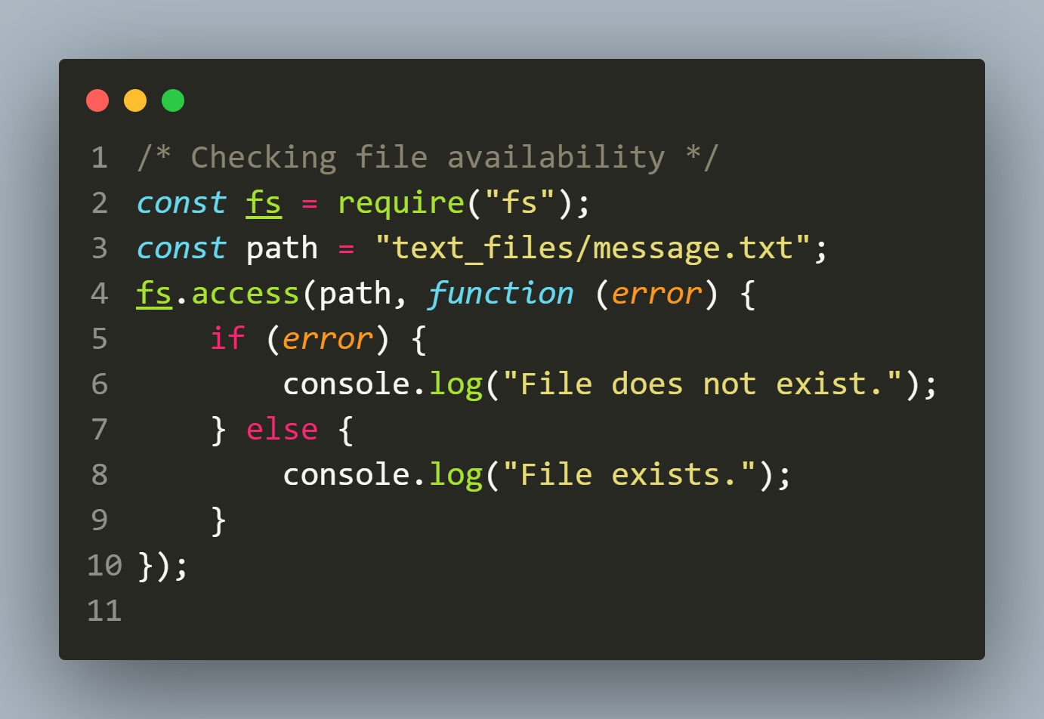
Solution

Slide 28
Writing to the file
The Node.js fs module provides two different functions for writing files:
writeFileSync(file,data,options)
writeFile(filename, data, options,callback)
Both functions take a file path , data and options as arguments, create the file if it is not present and write/overwrite the data to that file.

Slide 29
Difference ?
The key difference between them is that:
writeFileSync() is synchronous.
writeFile() is asynchronous.

Slide 30
Means ?
This means that writeFile() will return immediately, before the file has been written and only its callback will be called when the write operation is completed.
While writeFileSync() will block until the file has been written.

Slide 31
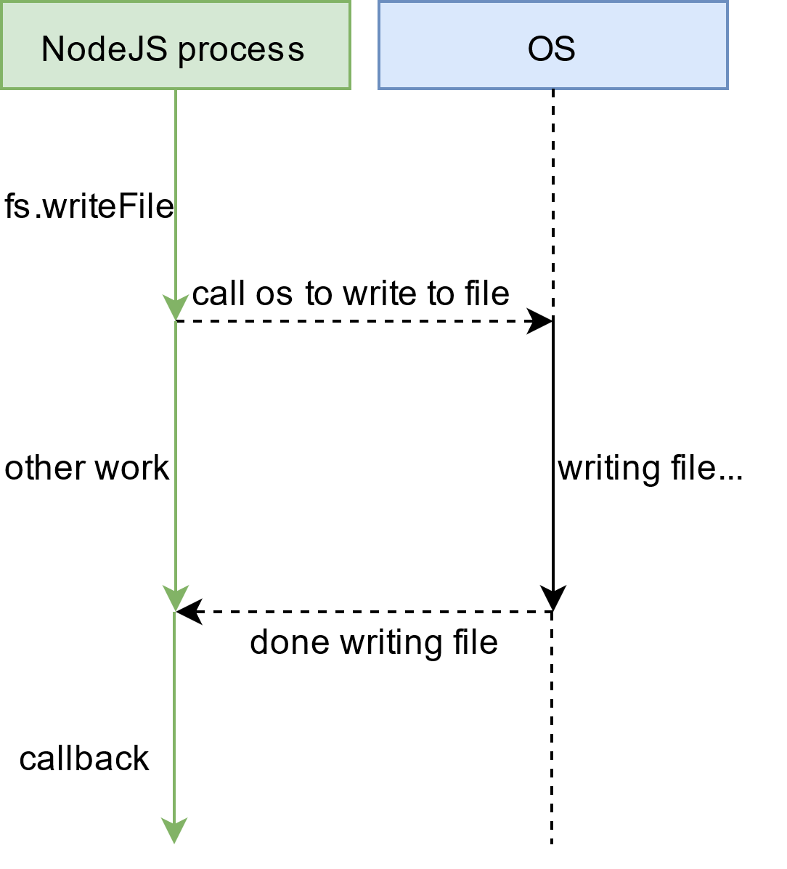
Working of writeFile()

Slide 32
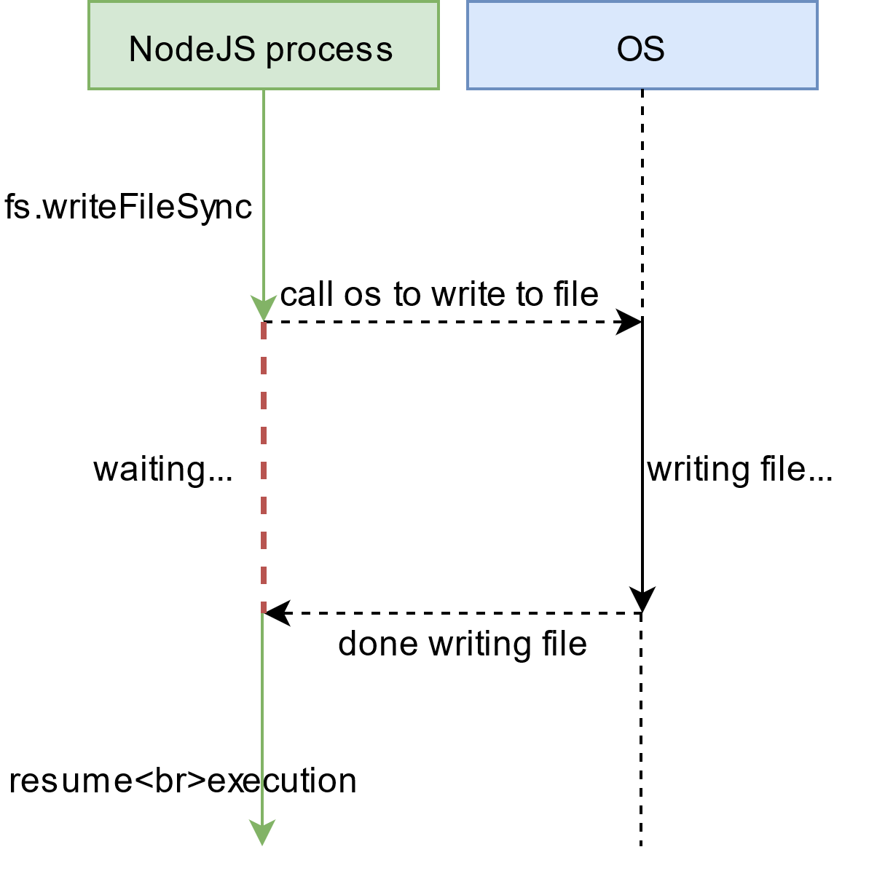
Working of writeFileSync()

Slide 33
The fs.writeFileSync() method
The fs.writeFileSync() method is synchronous and is used to write data to a file.
It takes three arguments: the file path ,the data to write and an optional argument called options and returns nothing i.e undefined.
Syntax:
fs.writeFileSync( file,data,options)

Slide 34
The fs.writeFileSync() method
Syntax:
fs.writeFileSync(path,data,options)
path: It is a String, Buffer or URL that denotes the path of the file or directory in which writing is to be done. If the file is not present it gets created and if it is present it gets overwritten
data: It is a String, Buffer or Object that needs to be written into the file.
options: It is an string or object that can be used to specify optional parameters that will affect the output. It contains encoding, mode and flag values

Slide 35
Exercise 3
WAS to create a file called message.txt in the text_files folder of your app .
Now write the message Welcome to Node.js in the file and at the end also write the current date and time in the file in locale specific format.

Slide 36
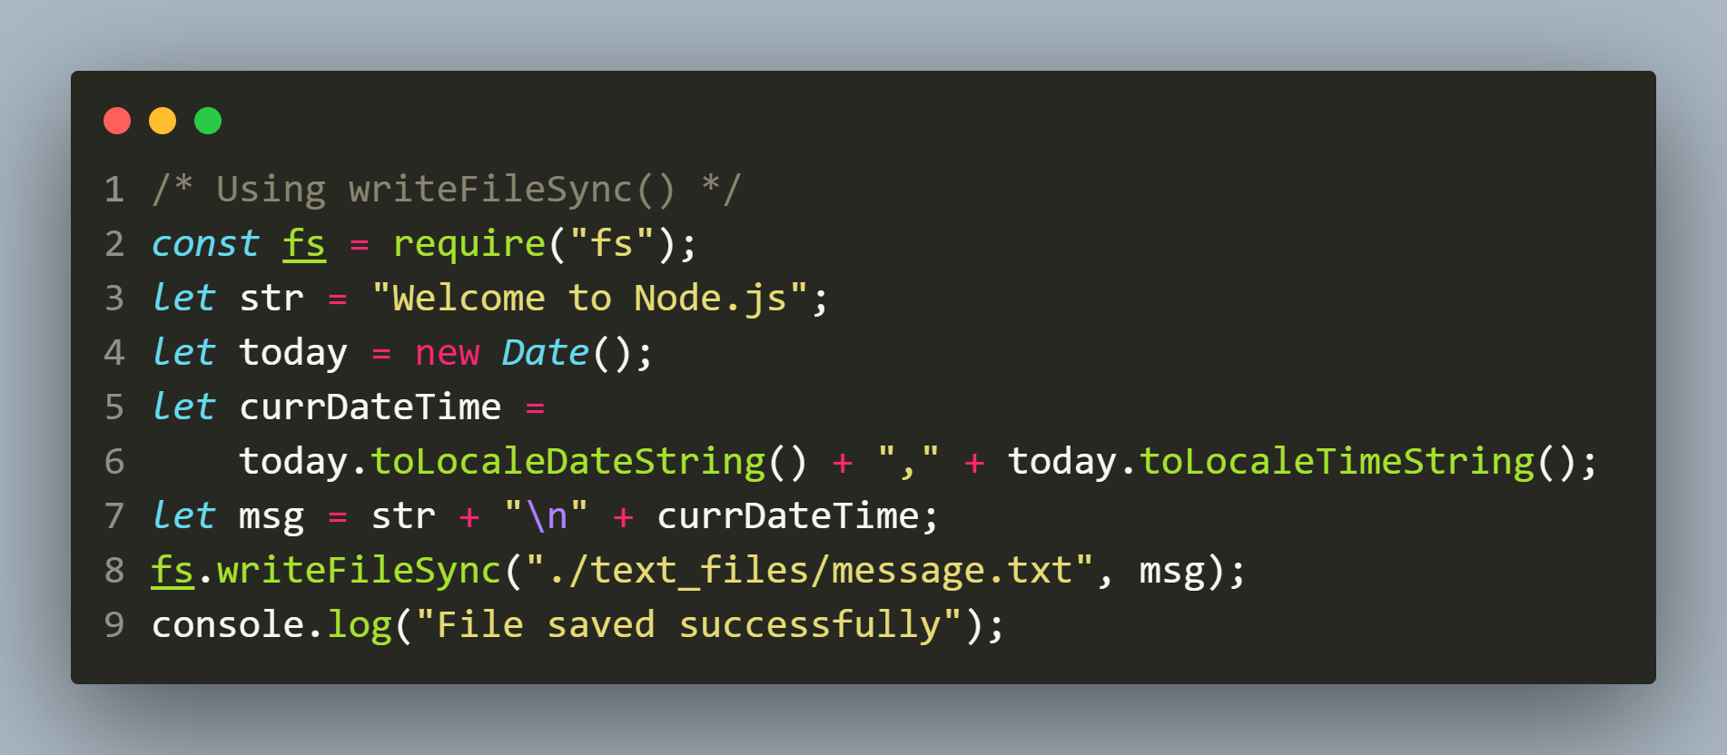
Solution

Slide 37
The fs.writeFile() method
The fs.writeFile() method is asynchronous and is used to write data to a file.
It takes four arguments: the file path, the data to write, an optional argument called options and a callback function that is called when the write is complete.
Like writeFileSync() this method also does not return any value
Syntax:
fs.writeFile(file,data,options,callback)

Slide 38
The fs.writeFile() method
Syntax:
fs.writeFile(path,data,options,callback)
path: It is a String, Buffer or URL that denotes the path of the file or directory in which writing is to be done. If the file is not present it gets created and if it is present it gets overwritten
data: It is a String, Buffer or Object that needs to be written into the file
options: It is an string or object that can be used to specify optional parameters that will affect the output. It contains encoding, mode and flag values
callback: It is a function that would be called when the method has finished its execution. It accepts a single argument representing error

Slide 39
Exercise 4
Rewrite the previous code using fs.writeFile() method

Slide 40
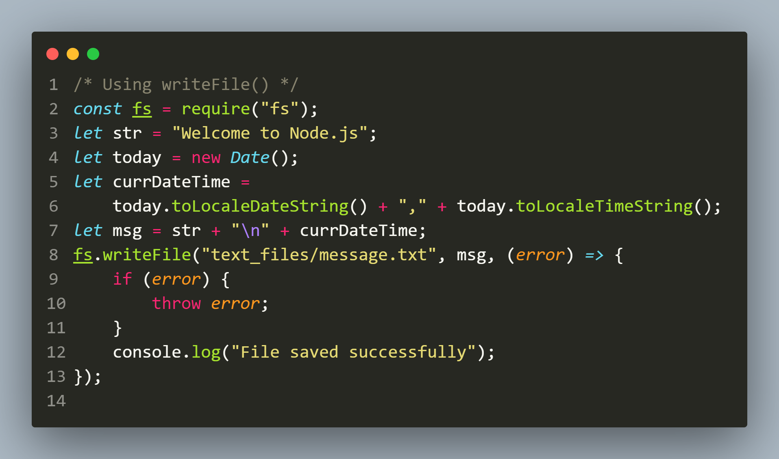
Solution

Slide 41
Errors in file operations
When working with the fs module of Node.js, it’s important to know file system errors and their handling to prevent any unexpected behavior in our application.
Following are three most common error types that we may encounter:
ENOENT
EACCESS
EEXIST

Slide 42
ErrorS in file operations
ENOENT (No such file or directory): Occurs when we try to read or write a file that does not exist.
EACCES (Permission denied): Occurs when we try to read or write a file without the required permissions.
EEXIST (File already present): Occurs when we try to open an existing file for writing.

Slide 43
HandLing errors
To handle these errors we can simply use try-catch block to wrap our file related function calls.
If we are using the async version then we can use the if statement to determine the error type and take the remedial action

Slide 44
Exercise 5
WAS to create a file called message.txt in the text_files folder of your app .
Now write the message Welcome to Node.js in the file and at the end also write the current date and time in the file in locale specific format.
Also handle the errors which might occur during the operation

Slide 45
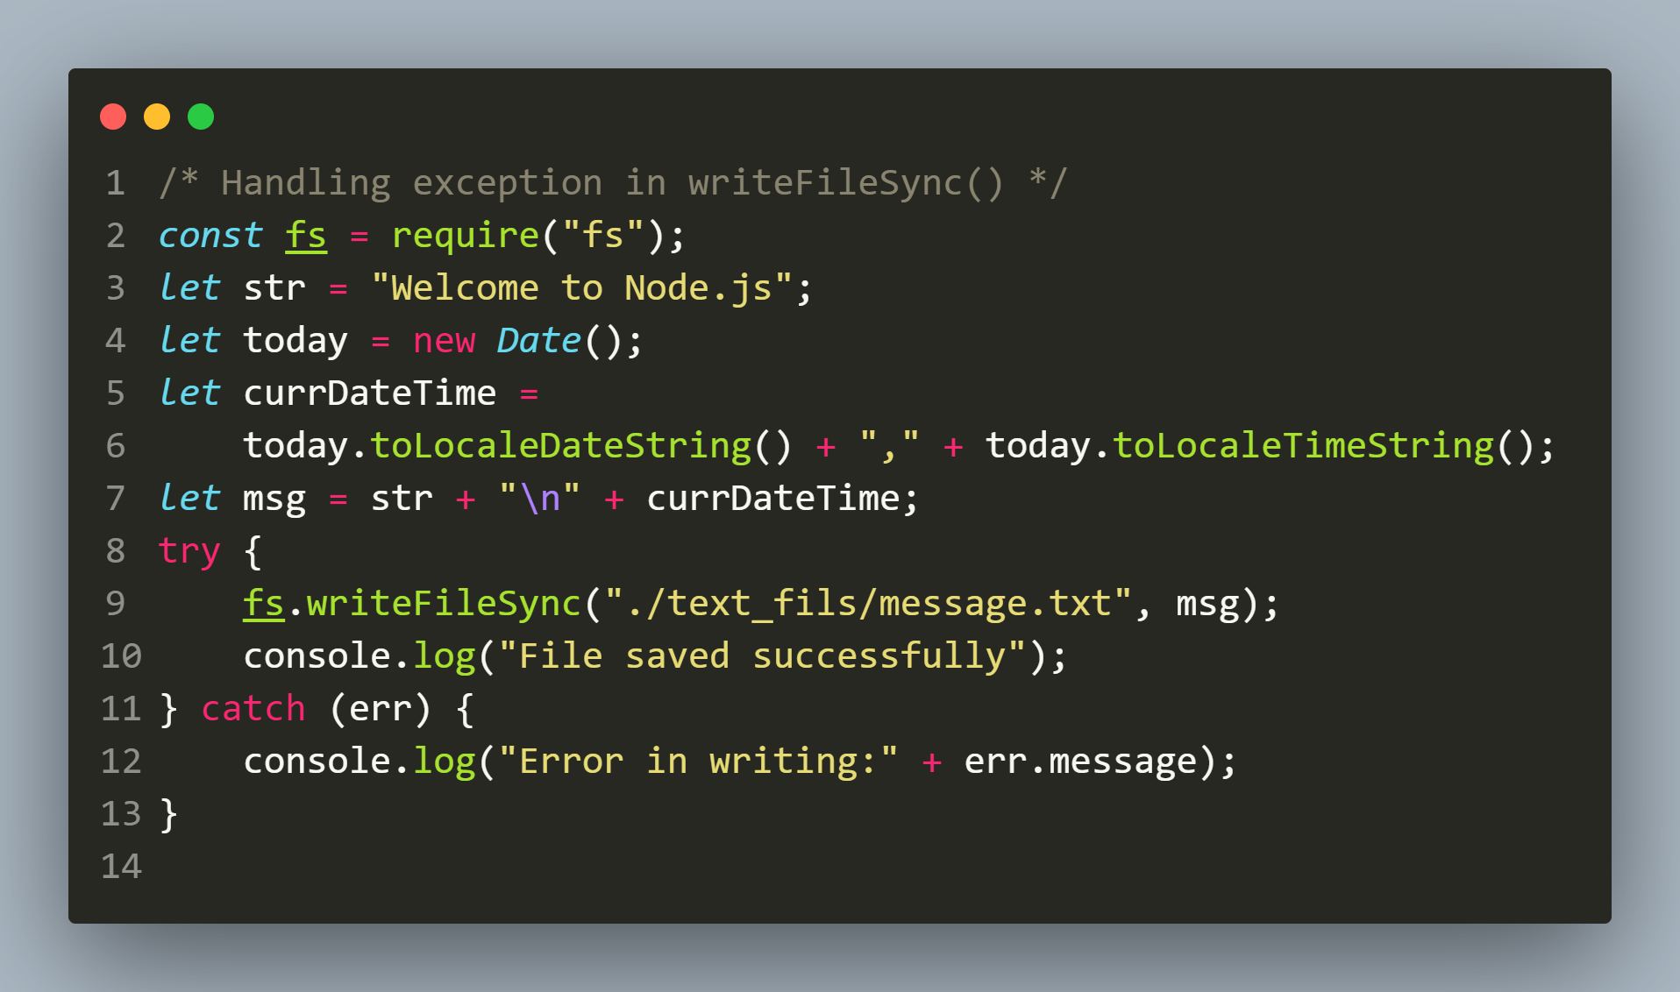
Solution

Slide 46
Exercise 6
Rewrite the previous code using fs.writeFile() method

Slide 47
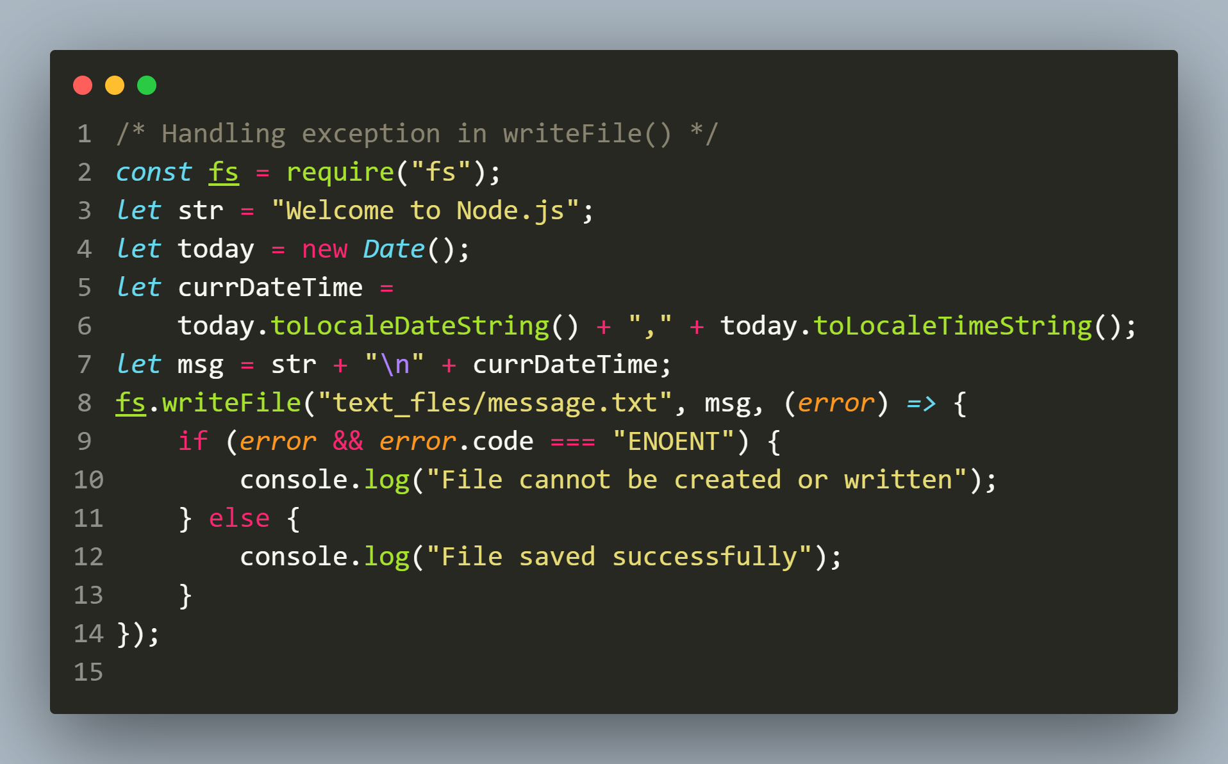
Solution

Slide 48
The options parameter
The third parameter of the writeFileSync() or writeFile() method is an object with three optional properties:
encoding
mode
flag

Slide 49
The options parameter
The encoding property has a default of utf8 and could be others like base64 etc.
The mode property sets the file mode (permission), and it only has an effect on newly created files. The default mode is 0o666 in octal

Slide 50
The options parameter
The flag property controls how the file will be created and written on.
The default flag is w, which creates the file (if the file does not already exist) or overwrites whatever data the file has with the new data (if the file does already exist).

Slide 51
The options parameter
Other flags are as follows:
a: creates the file (if it does not exist) or appends to the existing data (if it does exist)
ax and wx: creates the file (if it does not exist) or throws an error (if it already exists)

Slide 52
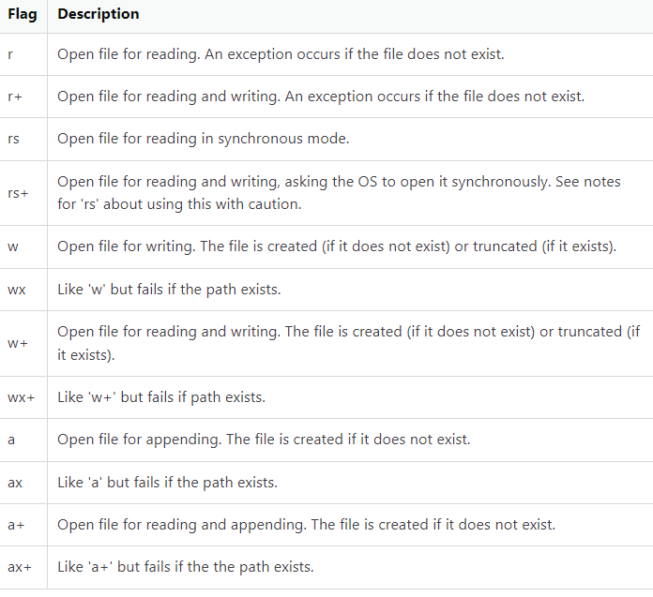
The options parameter

Slide 53
Exercise 7
WAS to create a file called index.txt in the text_files folder of your app .
Now write the message Welcome to Node.js in the file and at the end also write the current date and time in the file in locale specific format.
Make sure that the file gets created only if it is not already present , otherwise display the error message that file is existing

Slide 54
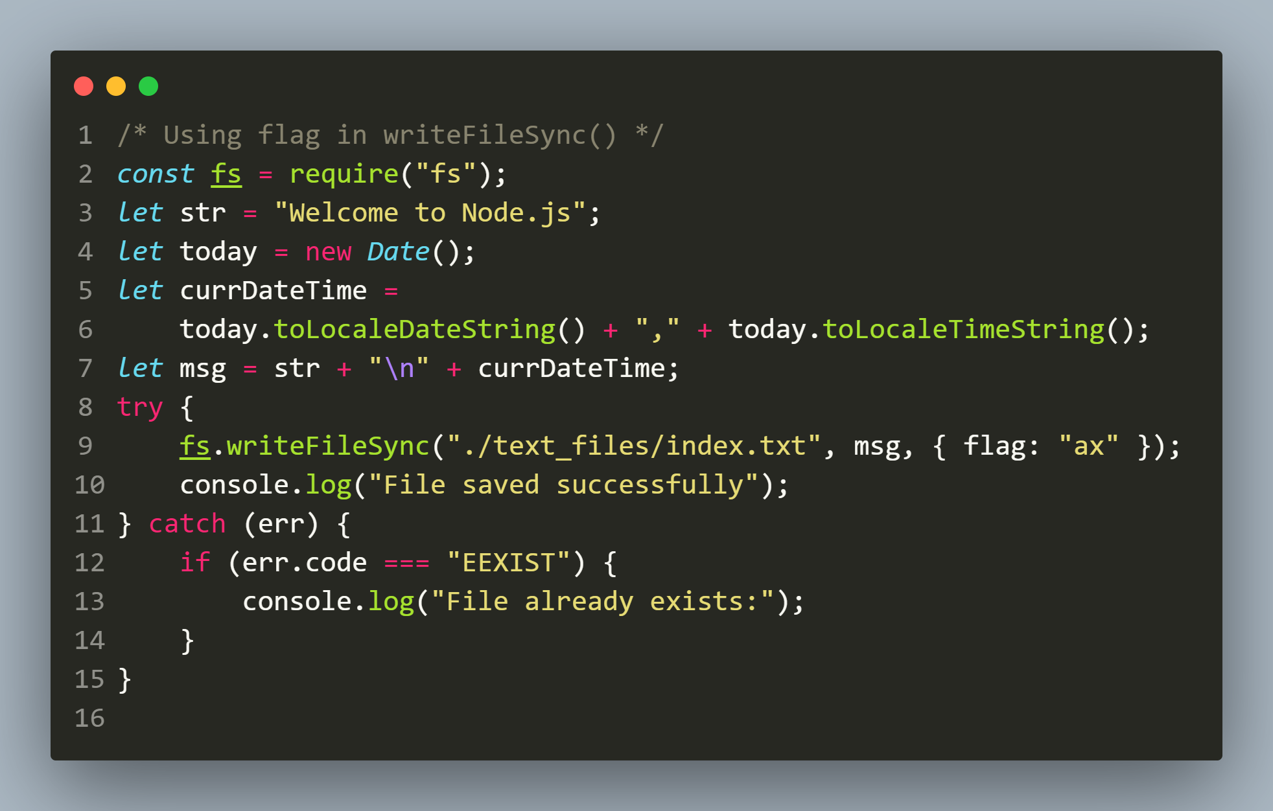
Solution

